Slide 1

Spam Email Classification Using Different Machine Learning Algorithms

Slide 2

Presented By- Supervised By-
Sadman Sadik 180104110 Faisal Muhammad Shah
Shaiuf Sadique 18104111 Associate Professor
Fabliha Nahid 180104116 Mr Sajib Kumar Saha Joy
Lecturer
Department of CSE
Ahsanullah University of Science & Technology

Slide 3
Introduction
Communication vary according to personal, business, corporate to Government.
Very easy and fast.
Can be vulnerable for attacks.
Classified into ham and spam

Slide 4
Problem Statement
We are working on classifying the spam email.
Machine Learning Algorithm will be applied to classify spam and ham email.

Slide 5
Related Study
Paper Title: Improved email spam detection model based on support vector machines
Corpus Benchmark Spam Dataset was used which is very popular and widely used.
The accuracy of the proposed model was 94.06% which was the highest accuracy on this dataset.
Paper Title: Email Spam Detection Using Machine Learning Algorithms
Machine learning algorithms like Naïve Bayes, Support Vector Machine, Decision Tree etc were implemented.
Email datasets from numerous websites like Sklearn, Kaggle was used here.
The best two algorithms for their model was Naïve Bayes and Decision Tree with accuracy 98% and 95% respectively.

Slide 6
Related Study (continued)
Paper Title: Comparative Analysis of Classification Algorithms for Email Spam Detection
Bayesian Logistic Regression, RBF Network, Hidden Naïve Bayes, Voted Perceptron algorithms were implemented.
Rotation Forest emerged as the best classifier with 94.2% accuracy.
Paper Title: Performance Evaluation of Machine Learning Algorithms for Email Spam Detection
The Spambase dataset was used.
Random Forest algorithm outperformed the other classification algorithms with a accuracy of 99.93%.

Slide 7
Applied Models
Multinomial Naive Bayes.
Decision Tree.
Random Forest.
Support Vector Machine.
K Nearest Neighbor.

Slide 8
Dataset
Collected from Kaggle named Email Spam Collection Dataset.
5574 messages.
Ham labeled as ‘0’ and Spam ‘1’.
4516 samples classified Ham and 653 samples classified Spam.

Slide 9
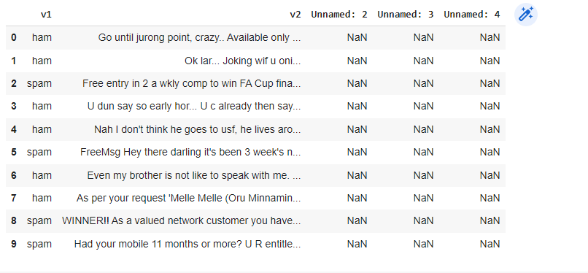
Dataset(continued)
Figure 2: Dataset before preprocessing

Slide 10
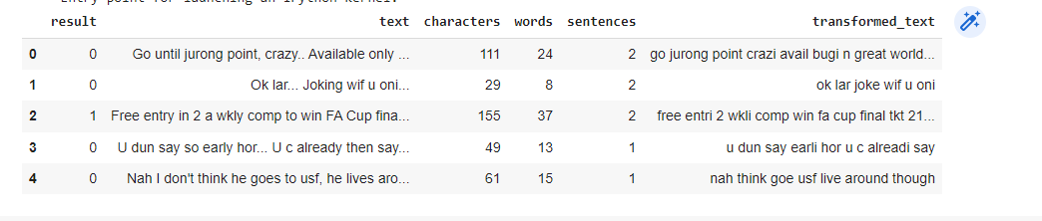
Dataset(continued)
Figure 3: Dataset after preprocessing

Slide 11
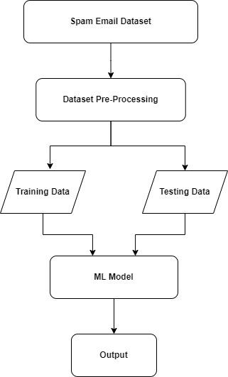
Proposed Methodology
Figure 1 : Methodology

Slide 12
Performance and Result
We achieved the best result for Random forest after that Multinomial Naïve Bayes gave the second highest result.
Model | Accuracy | Precession
SVM | 97.29% | 97.41%
KNN | 90.03% | 100%
Multinomial Naive Bayes | 95.93% | 100%
Decision Tree | 93.61% | 84.61%
Random Forest | 97.38% | 100%

Slide 13
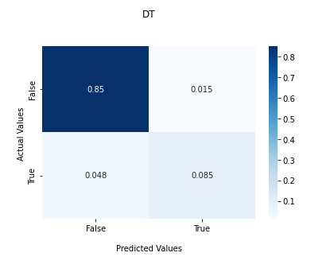
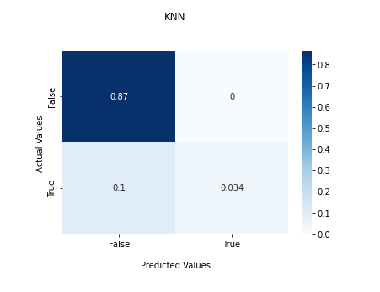
Confusion Matrix
Figure 4- Decision Tree Figure 5- KNN

Slide 14
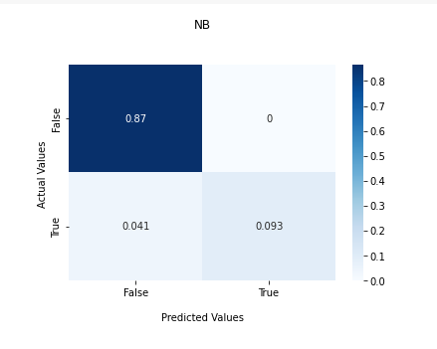
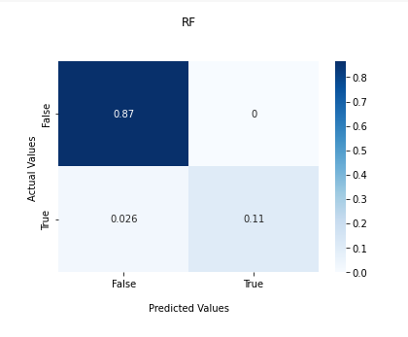
Confusion Matrix(continued)
Figure 5: Naive Bayes Figure 6: Random Forest

Slide 15
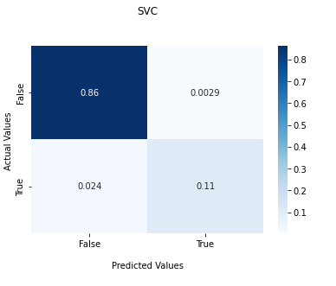
Confusion Matrix(continued)
Figure 7: SVM

Slide 16
Conclusion and Future Works
Applied five model.
Random Forest performed better according to result.
Will apply Deep Learning Model.
Collect enrich dataset.

Slide 17
Reference
[1] Improved email spam detection model based on support vector machines , Sunday Olusanya Olatunji
[2] Email Spam Detection Using Machine Learning Algorithms, Nikhil Kumar, Sanket Sonowal, Nishant
[3] Comparative Analysis of Classification Algorithms for Email Spam Detection, Shafi’i Muhammad Abdulhamid, Maryam Shuaib, Oluwafemi Osho, Idris Ismaila and John K. Alhassan
[4]Performance Evaluation of Machine Learning Algorithms for Email Spam Detection, Nandhini.S, Dr.Jeen Marseline.K.S

Slide 18
THANK YOU !

